Slide 1
ENEL 441
Control Systems I
Arne Dankers
12-01-2023

Slide 2
What is technology? Can de define “technology”?
Source: Technology Matters – Questions to Live With by David E. Nye

Slide 3
Updates
Next week I would like to use the tutorial as a lecture. This will help us get a head start on the material so that the material for Assignment 1 is covered.
I did not post instructions for installing Python and Jupyter Notebooks yet because I am co-ordinating with Mostafa Farrokhabadi (who is teaching ENEL487).

Slide 4
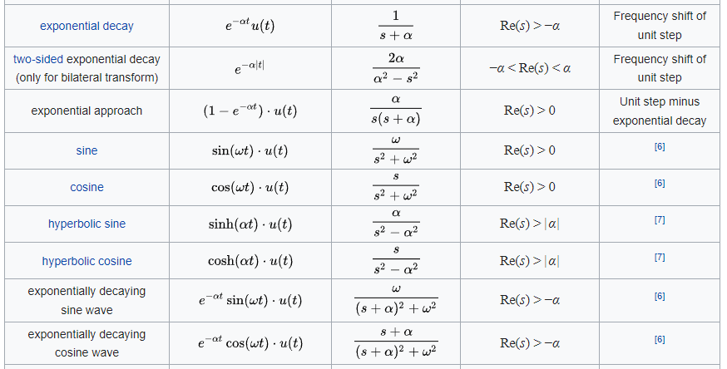
Laplace Transform Table
Source: https://en.wikipedia.org/wiki/List_of_Laplace_transforms

